Slide 1
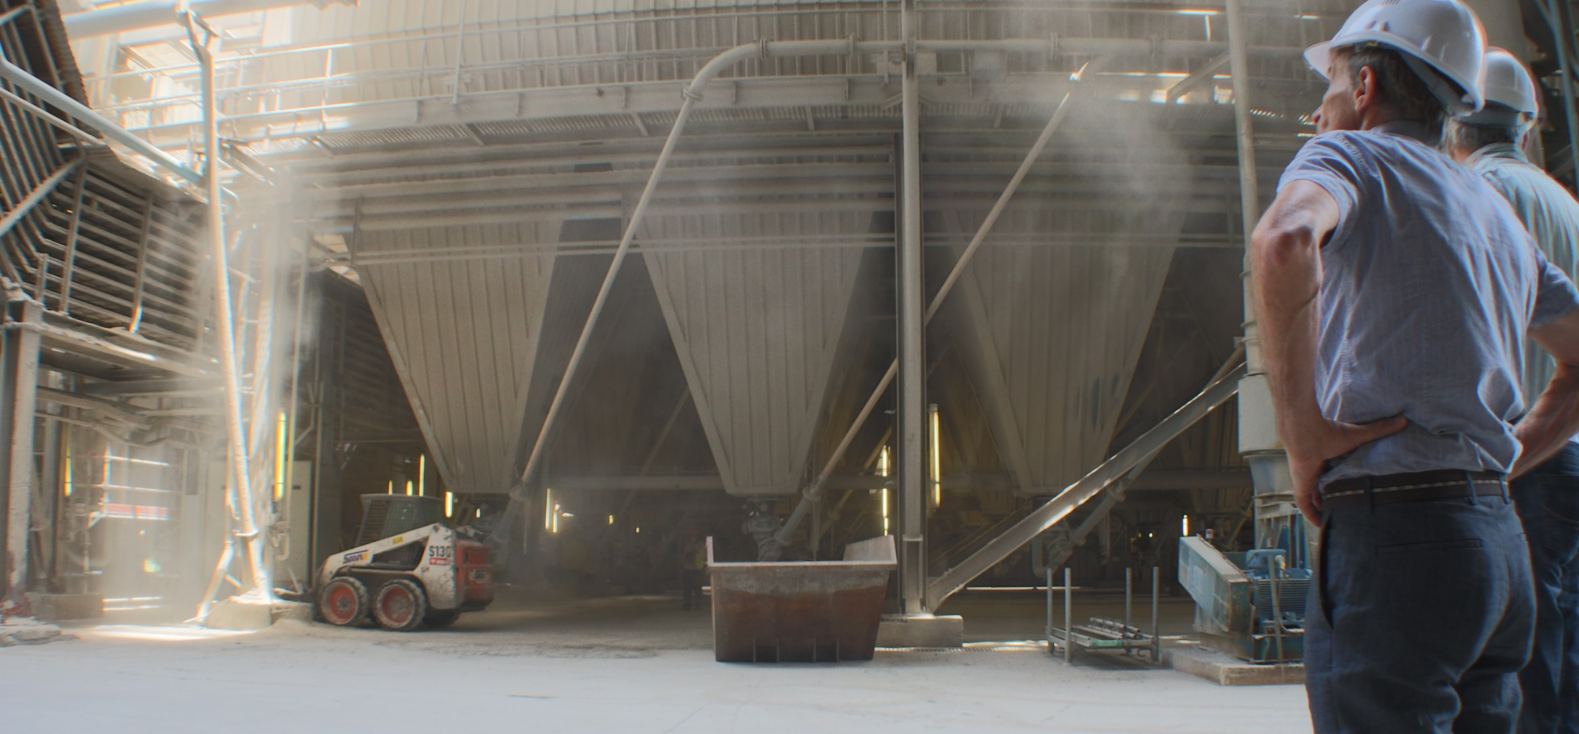
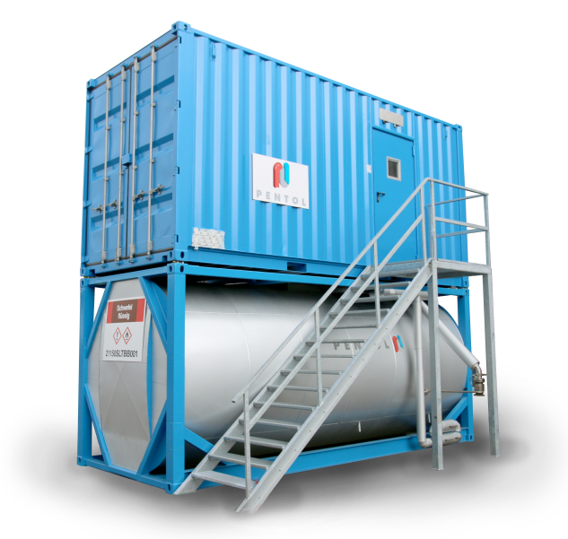
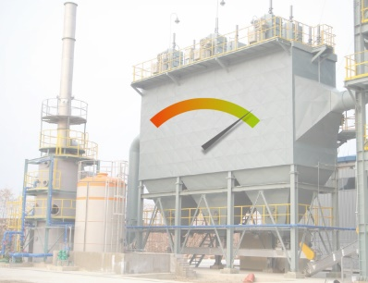
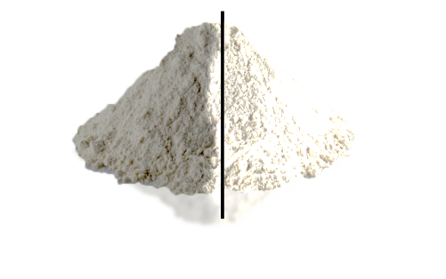
Flue Gas Conditioning for coal fired boilers
# ESP Efficiency
# White Gypsum

Slide 2








Who we are
Additives & technology for power plant optimization
What we offer
Founded in
1969, Germany
Fields of activity
Heavy fuel oil fired power plants, … Coal fired power stations, … Diesel engines, … Gas turbines, … Waste incinerators
Focused on
Emission problems, … Corrosion issues, … Inefficient heat-transfer
Working principle
We work as partner of plant operators (not just a supplier of commodities) – we work closely side by side
Our offer includes
Technical assistance, … Combustion tuning, … Emission monitoring, … Worldwide service network
^{Olivier Blauenstein, CEO}
Eric Blauenstein, Founder & President
Notes:
History
Since 1969 Pentol has continually served the power generation market with solutions to optimize efficiency of combustion and to minimize emission.
Initially serving heavy fuel oil fired power plants across Europe, Pentol's field of activity extended first to coal fired power station and later to diesel engines and gas turbines all over the world.
After 50 years we are proud to say that Pentol is well known across the globe as a reliable partner and supplier for the power industry.
Evolution
Pentol quickly learned that power plant operators are in need of partners and not suppliers of commodities.
For this reason, our extensive service network is available worldwide for technical assistance, combustion tuning and emission monitoring.
Our goal is to reduce emission in combination WITH an increase of efficiency of the plant.

Slide 3
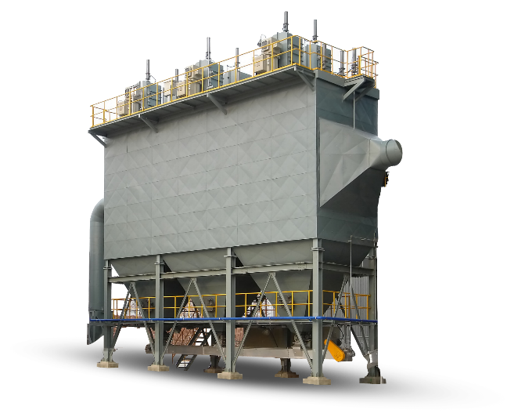



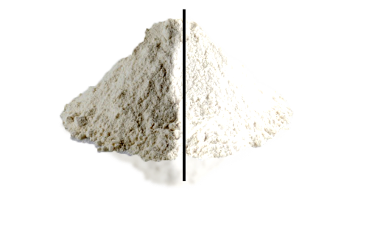

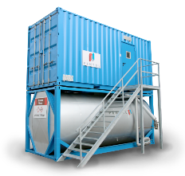
WHAT IS FLUE GAS CONDITIONING?
This presentation will show how to …
… REDUCE EMISSION
→
Solid emission is widely reduced
with the automatic control system
→
The Flue Gas Conditioning System of Pentol follows the boiler load and ensures optimal treatment of the fly ash and guarantees best ESP performance.
… Qualify Gypsum
→
How the carryover of dust particles is reduced strongly
… Whiteness of the gypsum
is increased
… Humidity is reduced
gypsum nuclei can grow bigger and are not limited in size by the dust particles.
… INCREASE ESP PERFORMANCE
→
How back corona & reentrainment is eliminated to extend lifetime of the precipitator.
… REDUCE FLY ASH RESISTIVITY
→
How ESP can work at its design efficiency and collect more fly ash.
Notes:
Over the years the pressure of cost efficiency has been rising and rising, forcing the power industry to switch to coals that their boilers and ESP were not originally designed for. In addition, the emission limits have gotten more stringent, FGD units have been retrofitted to existing power stations making operation more and more difficult.
Pentol Flue Gas Conditioning will offer you these advantages:
• Reduced dust emission
• Better gypsum quality.
HOW DOES IT WORK?
To reduce particle emissions, the EFFICIENCY of the ESP needs to be increased.
To increase the EFFICIENCY; the fly ash resistivity needs to be REDUCED. To reduce fly ash resistivity, SO3 is added to the flue gas. Higher efficiency of the ESP has 2 advantages: 1. The particles are captured directly in the ESP and not carried over to the desulphurization unit. 2. The gypsum quality is increased and the intervals between cleaning cycles are extended.

Slide 4
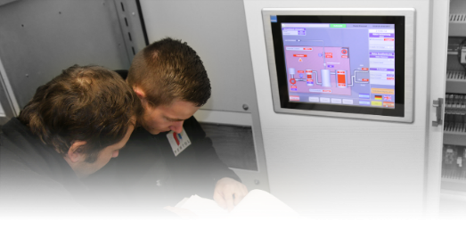
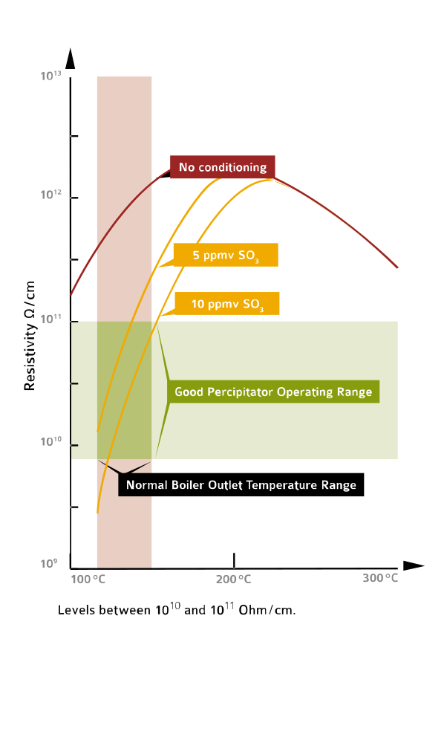
REDUCE FLY ASH RESISTIVITY
Temperature / resistivity - & SO₃ dosage
Why it´s important to pay attention on this:
→ ESP can run at its design capacity
→ Changing coal is getting easier by increase/decrease SO₃
→ Reduced back corona effect ESP lifetime extended
Notes:
The fly ash resistivity is an important parameter to design electrostatic precipitators and determine their size. For economic reasons, expensive filters should be designed as small as possible, which limits the coal types that can be used. Every coal or blend of coals has its own fly ash resistivity value that predicts how this coal or coal blend will affect the ESP. Flue gas conditioning of Pentol keeps the fly ash resistivity in a good precipitator operating range, allowing constantly low emissions with a broad range of coal types or coal blends. The size of the flue gas conditioning unit is selected based on coal quality, exit gas temperature and ESP design.

Slide 5
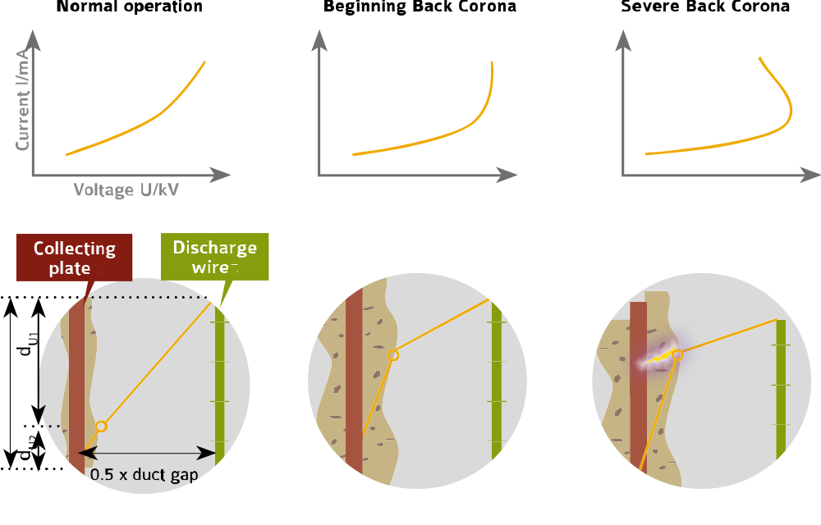

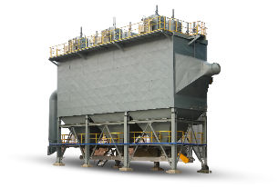
back corona
… and it´s effect on ESP performance
→ With FGC
you may unleash the full potential of your ESP
Collecting
plate
Discharge wires
Dust load
FRONT view
Notes:
Fly ash has an electrical resistivity that is been made use of by the electrostatic precipitator (ESP). The ESP produces a huge electrical field where the dust is collected on large steel plates. The collection speed depends on the fly ash resistivity. Typically, coal with low sulfur level tends to produce fly ash with high resistivity. The ESP cannot build up an electric field that is strong enough to collect high resistivity particles, leading to higher than usual emissions or a break through of the ESP at high load. Pentol Flue Gas Conditioning adds a small amount of SO3 to the flue gas. Just enough to reduce the fly ash resistivity, the ESP can now collect the dust properly and is running at its design capacity. Changing coal is getting easier, as the operator can simply increase or decrease the injection of SO3, preventing the need to mix different coals.
Avoid the back corona effect at dust collection SO3 is amazingly important because it naturally combines with the moisture in the flue gas to create sulfuric acid. Sulfuric acid immediately reacts with the fly ash particles to form a thin conductive film, which eventually lowers the fly ash resistivity. With the precipitator performing at its design efficiency, sparking and back corona is eliminated, extending the lifetime of the precipitator and allowing the operator to run the precipitator on rated current.

Slide 6
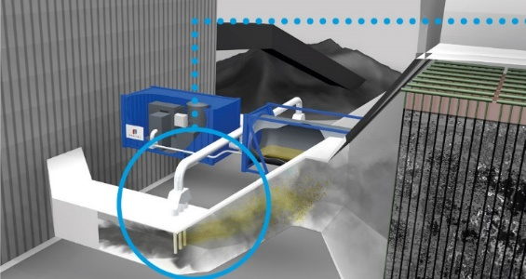
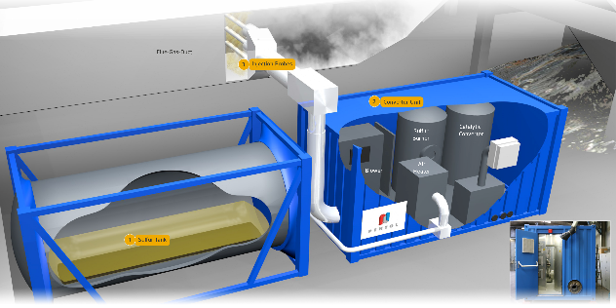
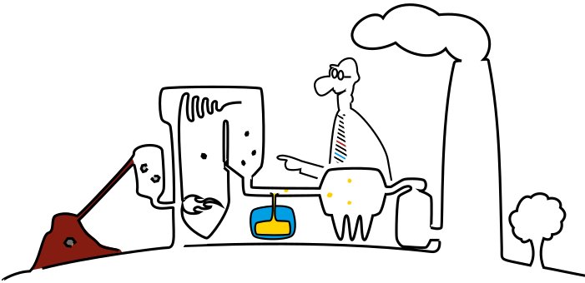
OPERATING PRINCIPLE
flue gas duct
injector probes
converter unit
PENTOL FGC-units are installed right before your ESPs
liquid sulfur storage tank
optional electric steam boiler
is injected into the flue gas stream by means of injection probes.
An SO₃/air mixture
The right quantity of SO₃ is produced online:
In the sulfur burner, the sulfur ignites, oxidizes to SO₂ and is converted to SO₃ with the Pentol TwinCat catalyser.
Notes:
Pentol Flue Gas Conditioning units consist of a converter unit, a liquid sulfur storage tank, injector probes and an optional electric steam boiler. The whole system is installed in a container in our workshop and comes completely tested to your site. The converter unit includes all electrical and the mechanical instrumentation and equipment that is needed to convert liquid sulfur into an SO3 / air mixture. Filtered ambient air is heated up well above the self-ignition temperature of sulfur by means of electrical heaters. In the sulfur burner, the sulfur ignites, oxidizes to SO2 and is converted to SO3 with the Pentol TwinCat catalyser. The SO3/air mixture is then injected into the flue gas stream by means of injection probes with typical dosage rates of 10 to 15 ppm. Depending on the availability of liquid or granulated sulfur, an appropriate tank has to be chosen. The complete installation is optimized to save energy. The energy required to keep the catalytic converter at its operating temperature is taken from the combustion process of the sulfur. This allows to reduce the electrical load to a minimum. In addition, the air flow is reduced at low loads to enhance the net efficiency of the unit.

Slide 7
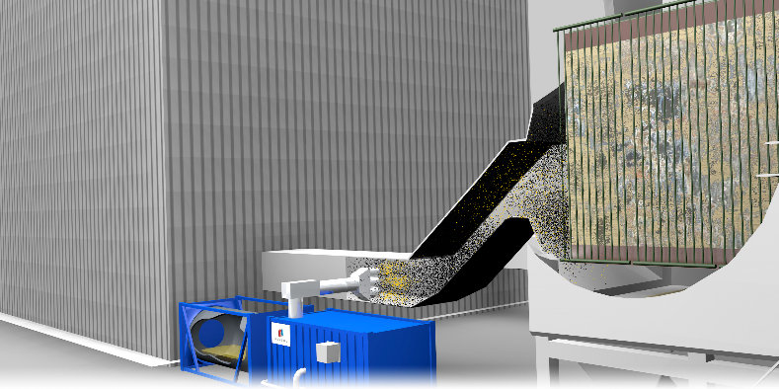
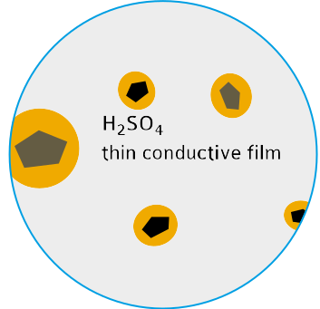
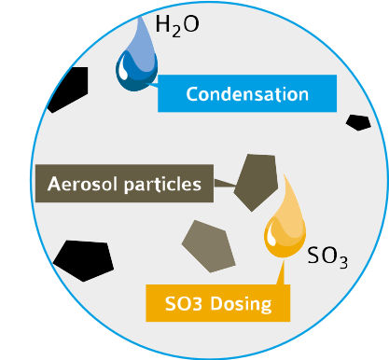
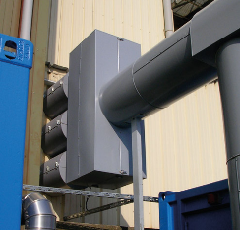
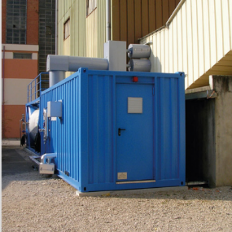
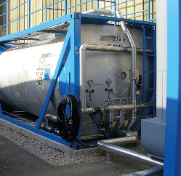
OPERATING PRINCIPLE
by injecting SO3 into the flue gas stream
→ reducing the fly ash resistivity
→ increasing the efficiency of your ESP
Notes:
The Pentol flue gas conditioning system is installed containers, making installation and start up quick and simple. The units are pre-tested and can be installed while the power station is running, reducing the down time of the plant to install the injector probes to one day only! Rental units are available for testing of the technology. This is interesting as in many cases, the existing ESP is in a bad state and the client has a broad range of available retrofits. A test unit can quickly show the potential of the existing ESP controller and mechanics. The test is therefore an important tool to minimize investment cost for a retrofit.
Pentol Flue Gas Conditioning is a simple and reliable way to optimize ESP efficiency. With a market share of 100% in Europe, we offer the best available technology to comply with particle emission legislation and reduce carry-over of dust into the FGD unit, increasing the gypsum quality and reducing wast water treatment cost. Pentol Flue Gas Conditioning has more or less the same effect as building an additional ESP field. Without the need for space, of course. And without changing the ductwork of your plant. And at a fraction of the cost.
Pentol Flue Gas Conditioning reduces solid emission …

Slide 8
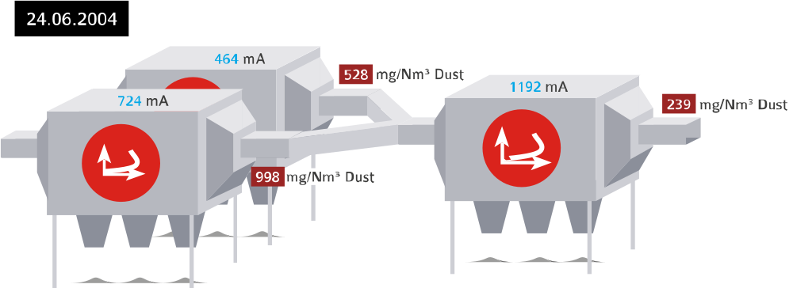
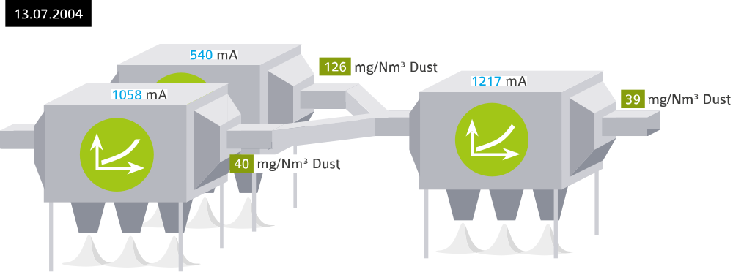
EXAMPLE of a retrofit in a German power plant.
Before
_{Issues:}
1. The FGD plant was fouled quickly
_{(cleaned every 5 weeks,} shutdowns, loss of power production)
2. increased humidity of the gypsum and fly ash particles captured in the FGD → the dark gypsum could not be sold but had to be disposed
3. The solid emission after FGD was exceeding the emission limit.
After
Notes:
This example shows the deployment of a FGC unit in a German power plant.
This specific boiler had some issues with combustion, leading to very high emissions after the 2 parallel ESPs. To solve that problem, a third filter was built in series to the existing ESPs. Unfortunately, due to the nature of the coal and the high resistivity of the ash, the 3rd filter wasn’t very effective in cleaning of the flue gas and dust was entering the FGD at a concentration of approx. 240 mg/Nm3. This very high dust concentration lead caused several problems: 1. The FGD plant was fouled quickly and had to be cleaned every 5 weeks, resulting in regular shutdowns and loss of power production. 2. The growth of the gypsum particles was limited, increasing the humidity of the gypsum and the fly ash particles captured in the FGD reduced the whiteness of the gypsum. As a result, the gypsum could not be sold but had to be disposed of. 3. The solid emission after FGD was exceeding the emission limit. Pentol conducted a test on this boiler with one of our mobile FGC units. After a few days of operation only, the dust concentration after the 3rd ESP did not exceed 39 mg/Nm3 anymore, eventually stabilizing at <20 mg/Nm3. Within a few days and with a minor investment, the 3 points mentioned above were solved and the test unit was never returned and our customer decided to equip five more boilers with FGC.
Before installing FGC technology, a third ESP has been built in-between the existing ESPs and the FGD unit.
Nevertheless, emission was too high for the FGD, (> 200 mg/Nm3), necessitating to shut down the boiler every 5 weeks to clean the FGD unit.
After installing the Flue-Gas-Conditioning system
Only hours after starting the FGC system, the emission dropped from 240 mg/Nm3 to <40 mg/Nm3 before FGD. The filter has been cleaned within hours and up to the end of operation of this boiler (around 10 years later), the FGC unit has been running permanently without any interruption.

Slide 9
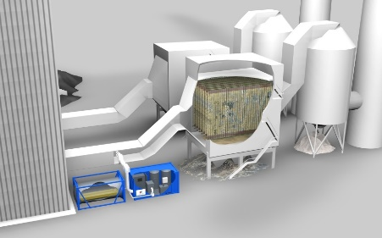
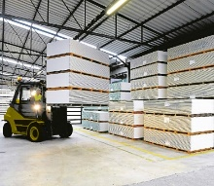
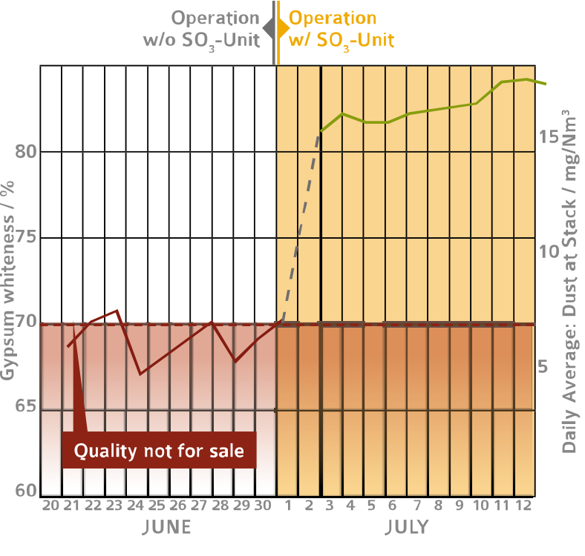
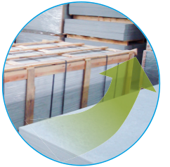
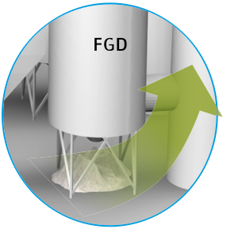
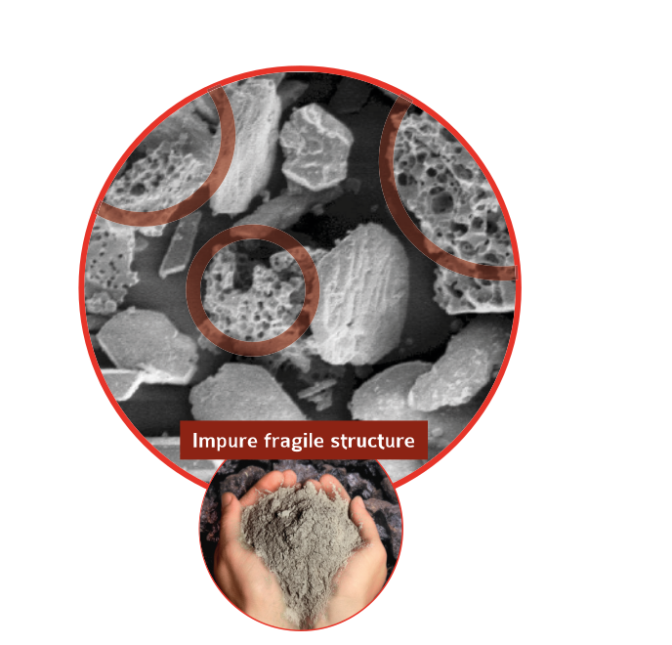

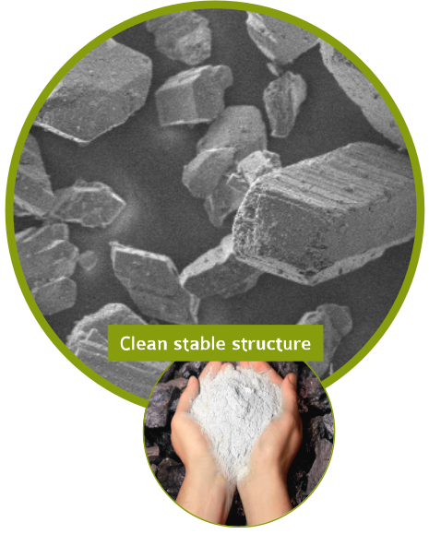
INCREASE WHITENESS OF gypsum
Notes:
In most countries, exceeding the emission limit forces the reduction of power production of the unit. The loss of production pays the cost of a complete Pentol FGC unit in a few days. This is why Pentol keeps mobile rental units available for testing, wherever an urgent need arises. For plants equipped with FGD who sell their gypsum, a similar situation exists with FGD availability. If FGD is polluted by dust, the washers need to be cleaned regularly and the dust particles hinder the particle grow of the gypsum, resulting in a grey, watery gypsum of low quality. With Pentol Flue Gas Conditioning, whiteness and humidity of the gypsum are easily increased to comply with your buyer’s specification.

Slide 10
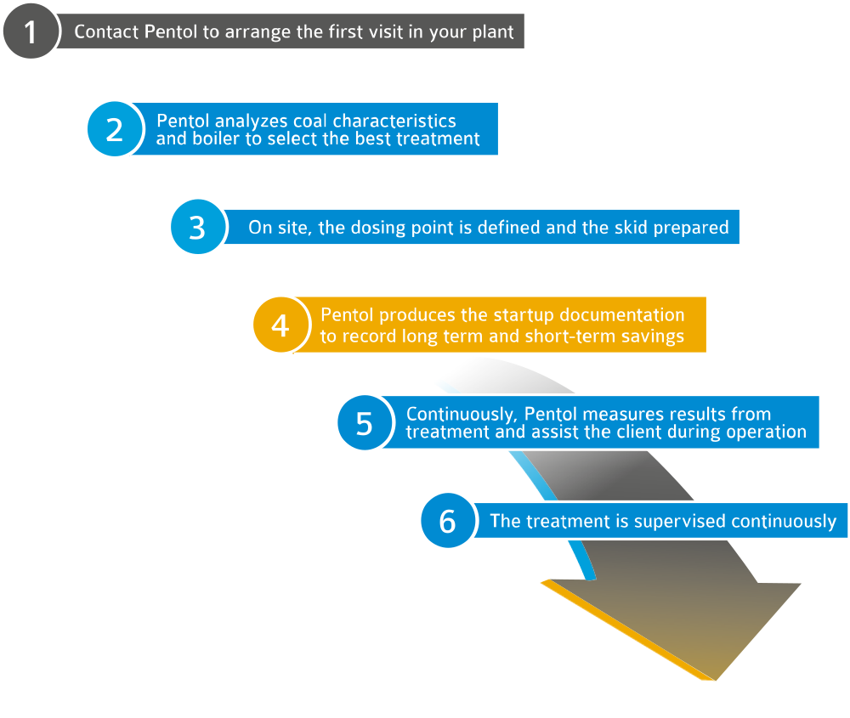

get in touch personally
Our first contact
GO
Notes:
The fly ash resistivity is an important parameter to design electrostatic precipitators and determine their size. For economic reasons, expensive filters should be designed as small as possible, which limits the coal types that can be used. Every coal or blend of coals has its own fly ash resistivity value that predicts how this coal or coal blend will affect the ESP. Flue gas conditioning of Pentol keeps the fly ash resistivity in a good precipitator operating range, allowing constantly low emissions with a broad range of coal types or coal blends. The size of the flue gas conditioning unit is selected based on coal quality, exit gas temperature and ESP design.

Slide 11
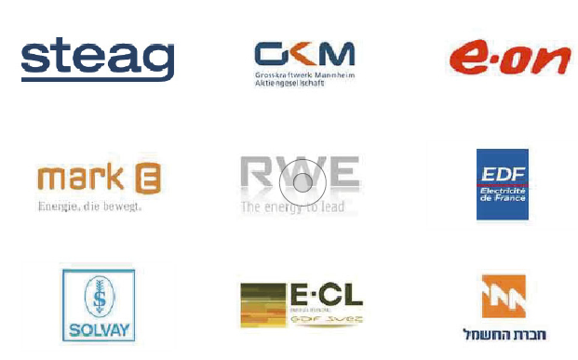
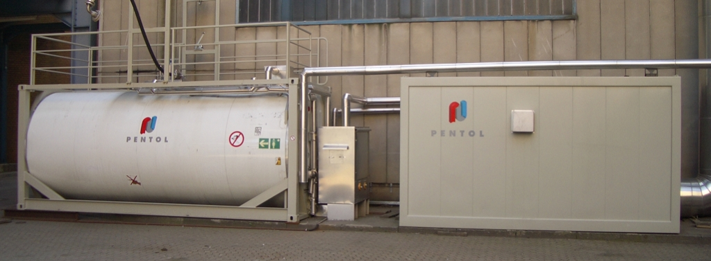
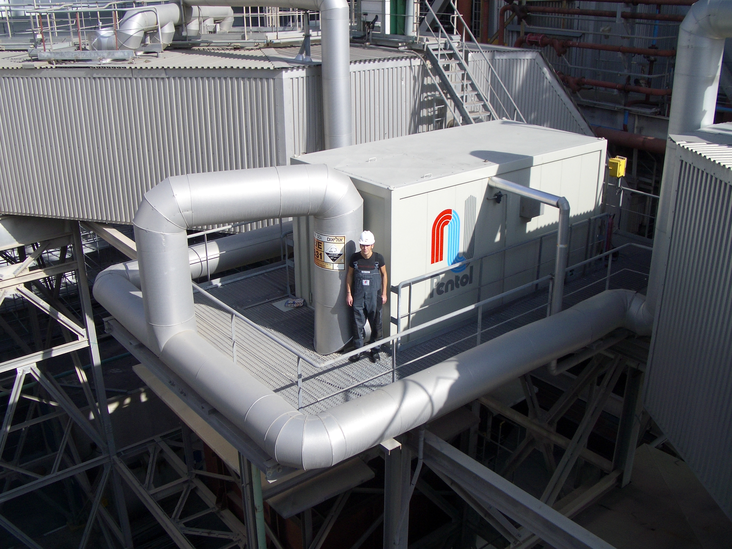
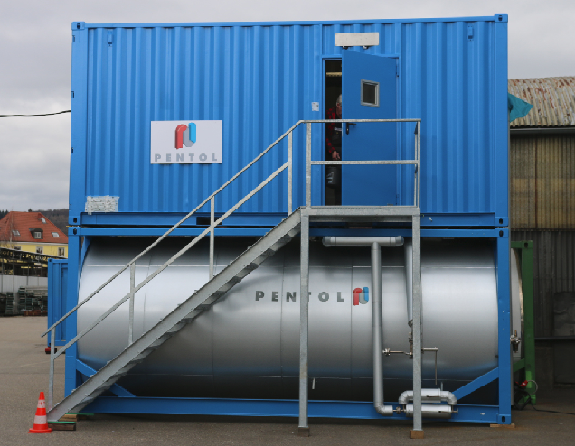
REFERENCES more than 100 units built for Europe, South America and Asia
Notes:
The fly ash resistivity is an important parameter to design electrostatic precipitators and determine their size. For economic reasons, expensive filters should be designed as small as possible, which limits the coal types that can be used. Every coal or blend of coals has its own fly ash resistivity value that predicts how this coal or coal blend will affect the ESP. Flue gas conditioning of Pentol keeps the fly ash resistivity in a good precipitator operating range, allowing constantly low emissions with a broad range of coal types or coal blends. The size of the flue gas conditioning unit is selected based on coal quality, exit gas temperature and ESP design.

Slide 12
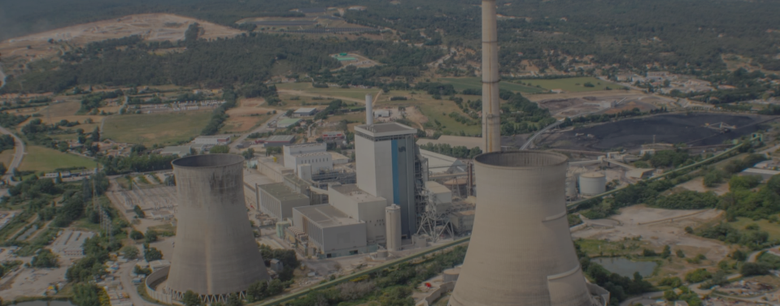






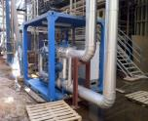



Come and visit us ! on www.pentol.net
We have cookies …
and we have a live chat
Find case studies
Contact us for support
Find PDF Downloads
Notes:
We are always working hard on our Pentol website.
You can see
- happy customers @deployment stories
- Other products like boiler cleaners @downloads
- Worldwide support @contact

